Slide 1
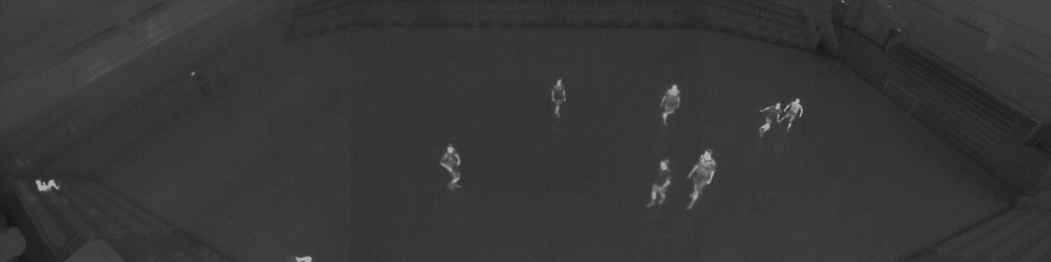

Thermal Tracking of Sports Players
Rikke Gade, Thomas B. Moeslund
VGIS8 group 843
Rita and Atanas

Slide 2
Thermal camera
Light independent sensor
Preserves privacy

Slide 3
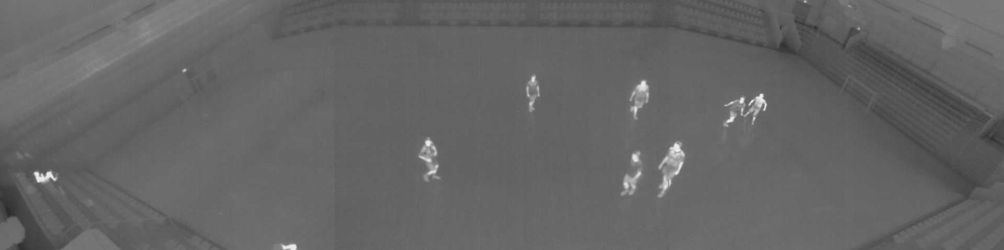
Data set
Four 30 seconds videos of a soccer game on a public sports arena
Videos from 3 cameras stitched together
Challenge: unpredictable and erratic motion

Slide 4
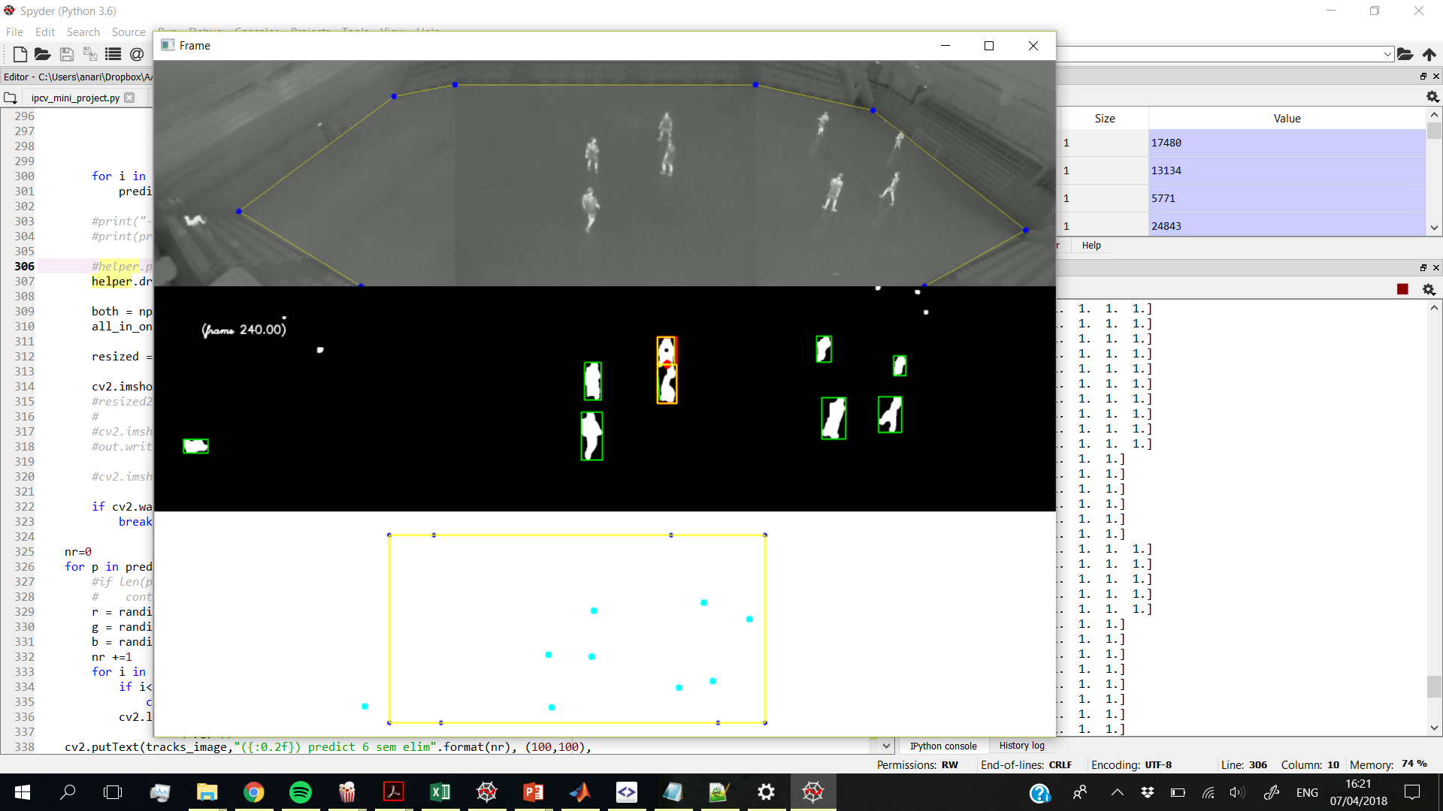
Initialization
To find peoples’ locations in the court a mapping is done from video coordinates to court/world coordinates
A homography matrix is calculated from the points in the images

Slide 5
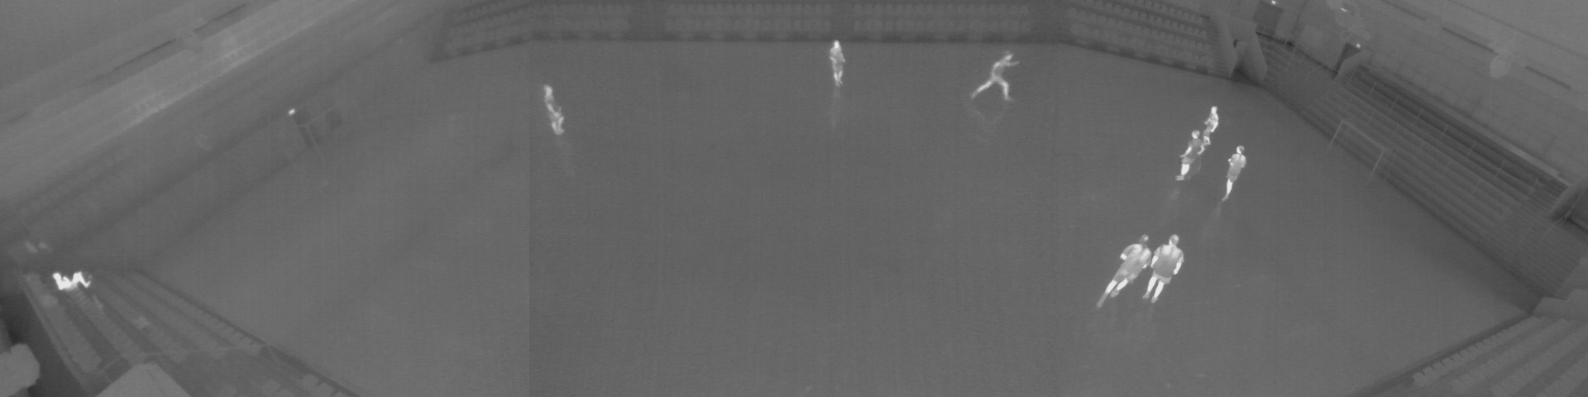
Detection

Slide 6
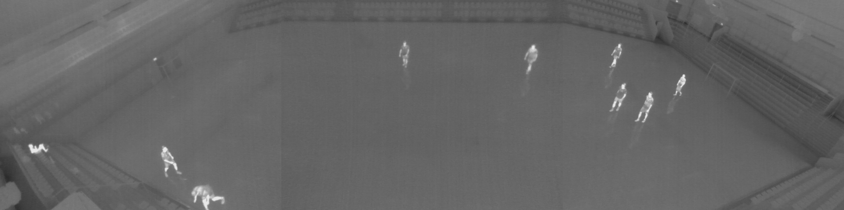
Segmentation
Thresholding
Dilation and erosion

Slide 7
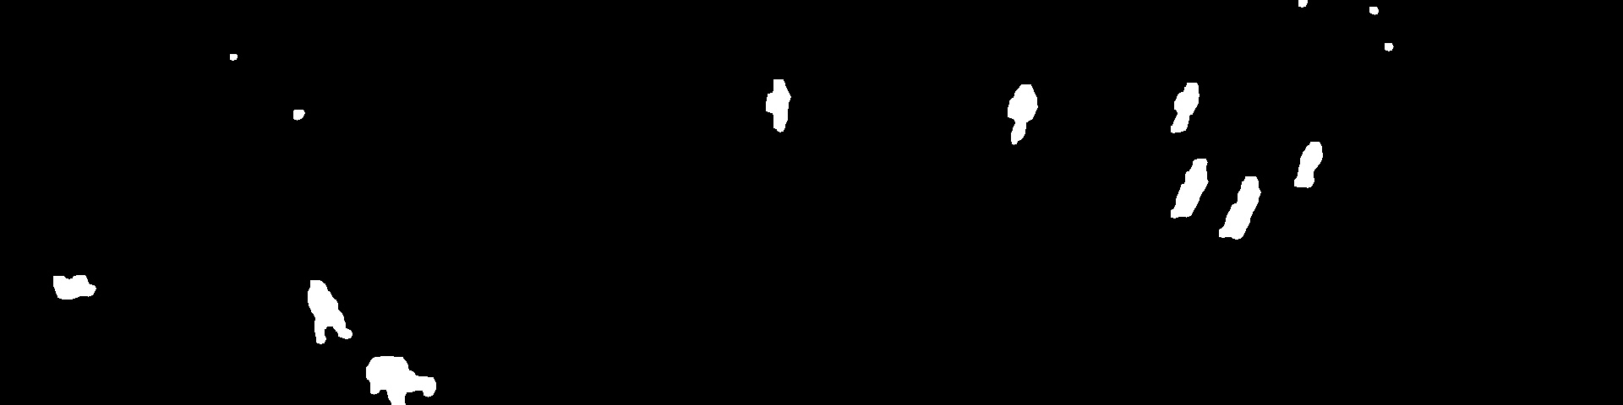
Segmentation
Thresholding
Dilation and erosion

Slide 8
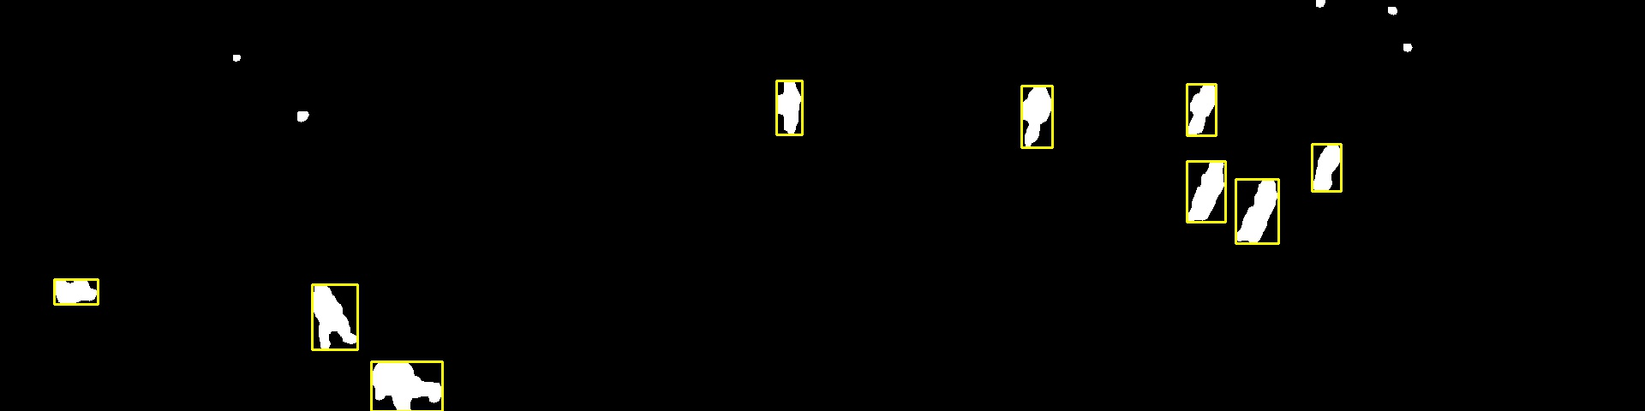
Detect contours

Slide 9
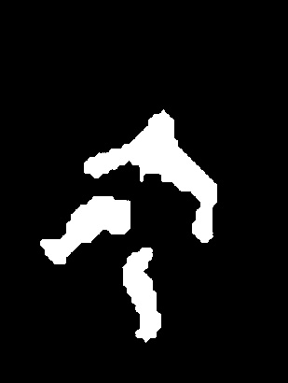
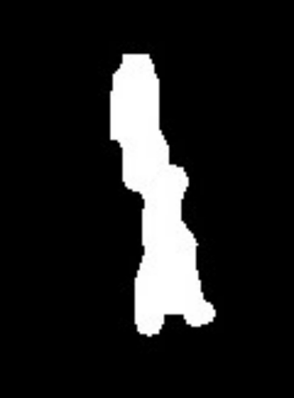
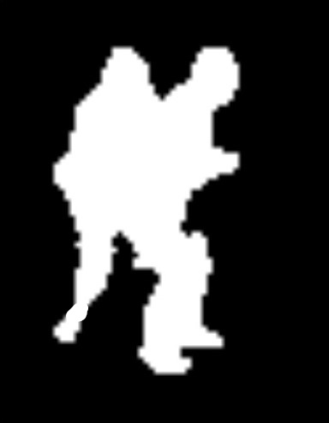
Challenges
Connect blobs
Split tall blobs
Split wide blobs

Slide 10
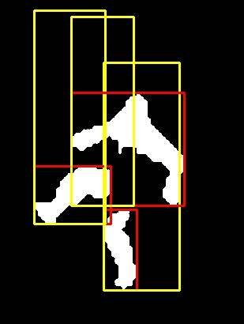
Connect Blobs
Generate a rectangle of standard height at the location of each blob with the width being one third of the height
For each rectangle, the ratio of white pixels is calculated
If the ration is below 15% the blob is discarded

Slide 11
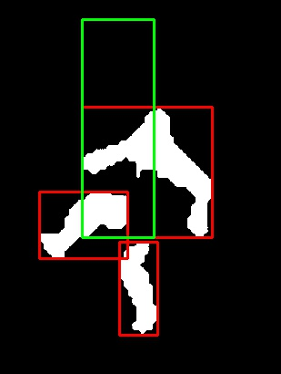
Connect Blobs
If two rectangles overlap by more than 15%, the candidate with the highest ratio of white pixels is kept as the true detection

Slide 12
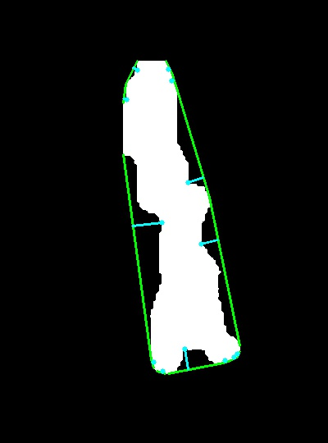
Split tall blobs
If a blob has a height larger than a maximum height at the given position the algorithm tries to split the blob horizontally
The convex hull and convexity defects of the contours are detected

Slide 13
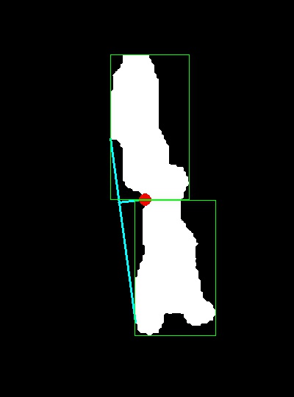
Split tall blobs
The point selected to split from is the defect point with the largest depth and a maximum gradient of 1.5 (only defects from the side are considered)
The defect point should not be in the top or bottom fourth of the region
The region is split horizontally from the selected point

Slide 14
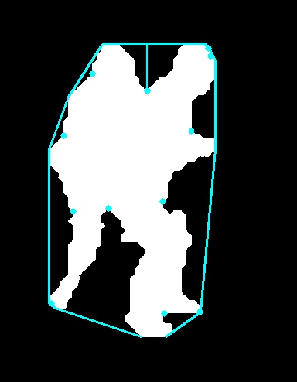
Split wide blobs
The algorithm will try to split a blob vertically if a blob's bounding box height is less than five times the width and the contour of the region is larger than the bounding box perimeter
The convex hull and convexity defects of the contours are detected

Slide 15
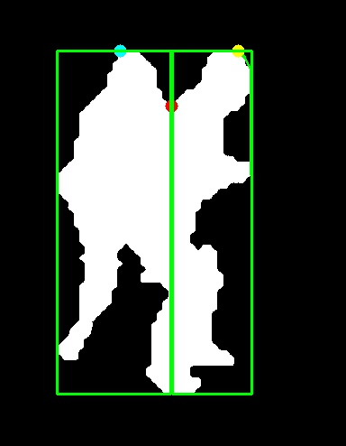
Split wide blobs
The idea is to separate the people based on their head position
The defect must be on the upper edge of the region and have a y-value greater than both the convexity defect’s start and end point to make it a minimum point

Slide 16
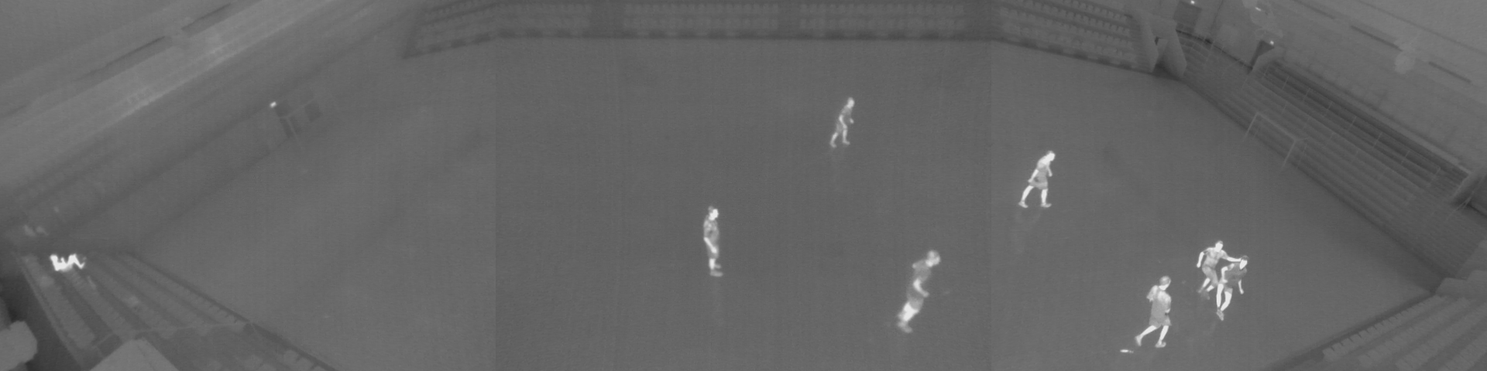
Tracking

Slide 17
Kalman filter
Recursive algorithm that predicts the next step from the previous state, filtering noisy measurements, and uses the new measurement to update the estimate

Slide 18
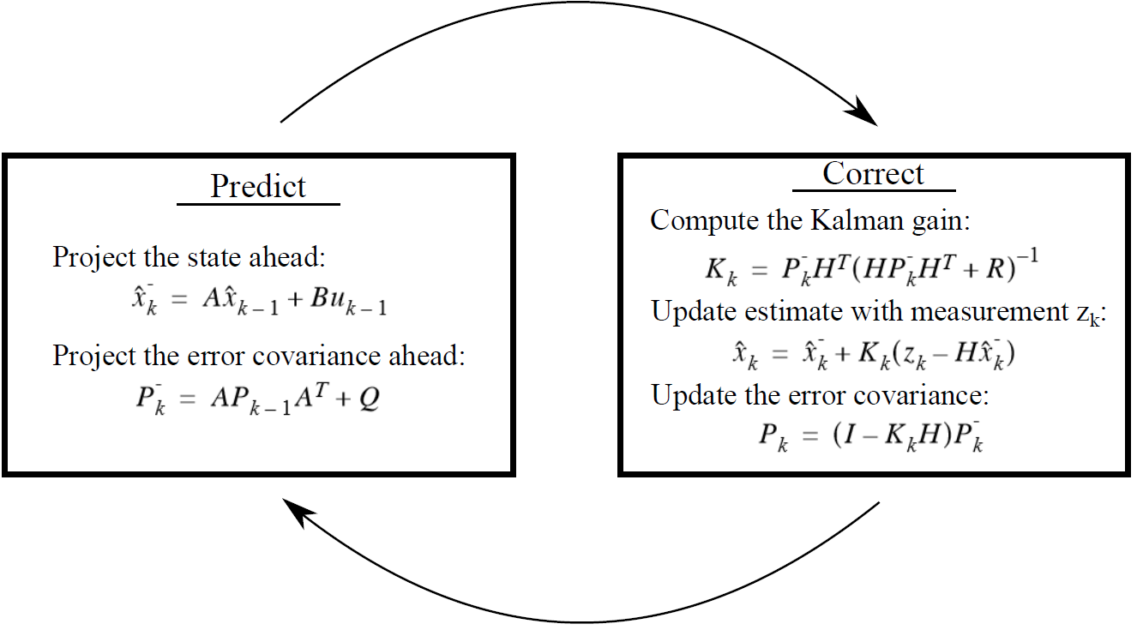
Kalman filter
Gade, R., & Moeslund, T. B. (2014). Thermal Tracking of Sports Players. Sensors, 14(8), 13679-13691. DOI: 10.3390/s140813679

Slide 19
Tracking
For each detected person a new Kalman filter is created
In each frame a Kalman filter is assigned the nearest detection (given a distance threshold)
For each detection not assigned to a Kalman filter, a new one is created, thus beginning a new track
Kalman filters with no assigned detections are still continued based on predictions for a maximum of 5 frames without detections

Slide 20
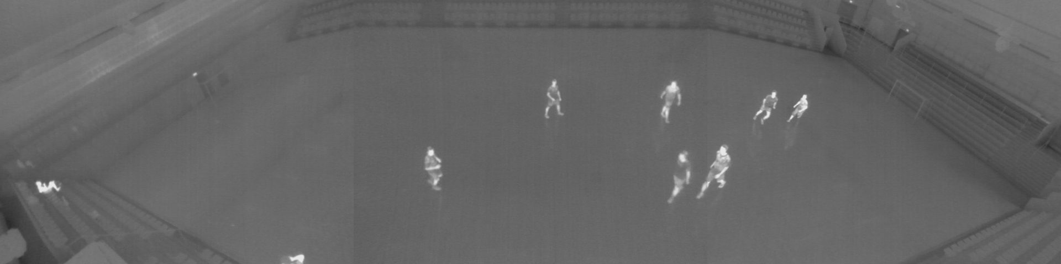
Results

Slide 21

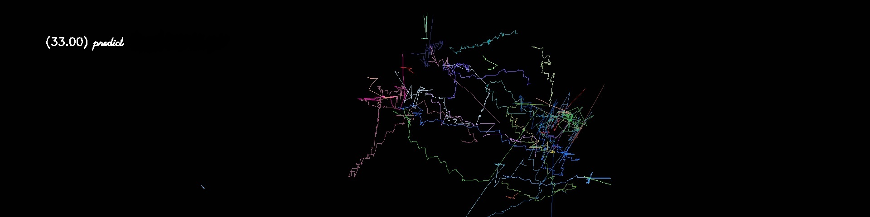
Video 1
Ground truth
Result

Slide 22

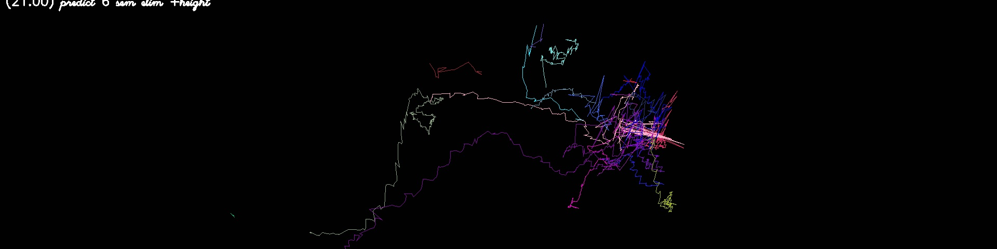
Video 2
Ground truth
Result

Slide 23

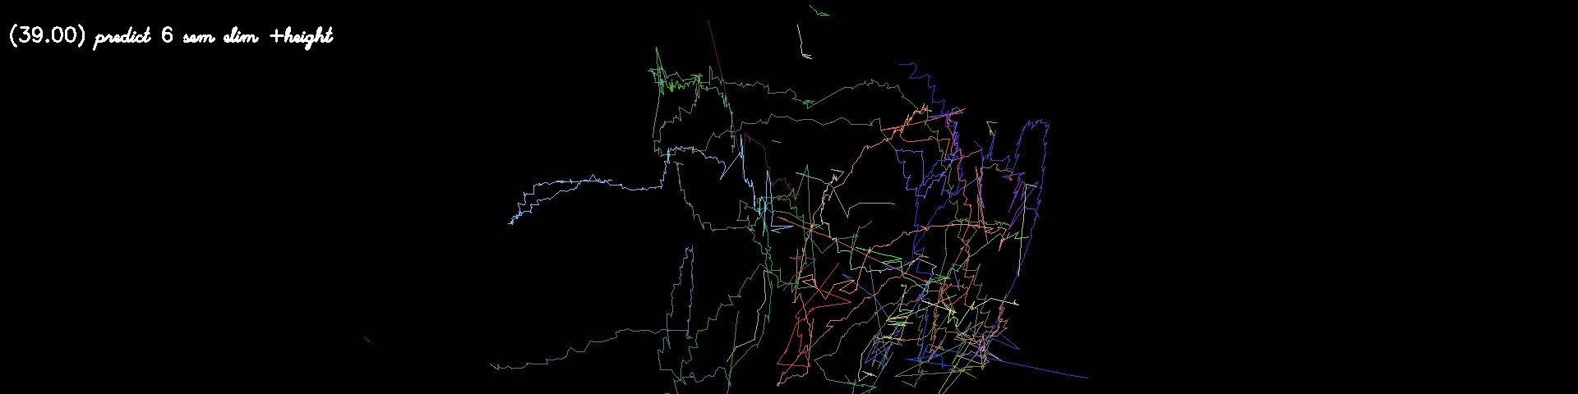
Video 3
Ground truth
Result

Slide 24

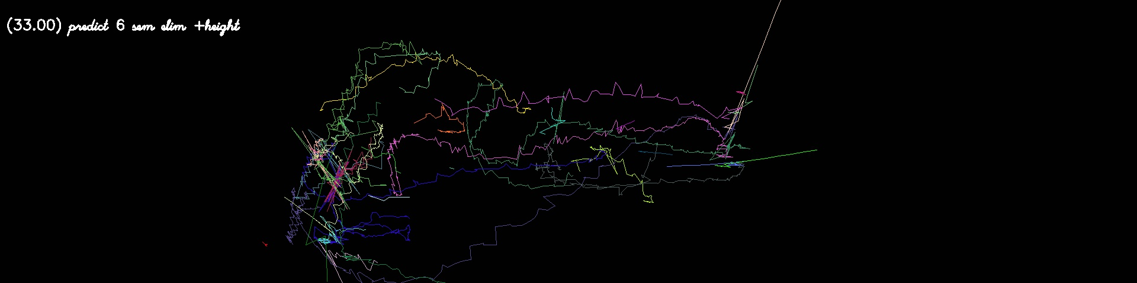
Video 4
Ground truth
Result

Slide 25
Thanks!!
Any questions?

